Slide 1

Amazon Delivery Time Prediction
Regression-Based Machine Learning Project
Presented by: Marjeena PN

Slide 2

Introduction
The Delivery Challenge
Fast, reliable delivery drives customer satisfaction in modern e-commerce
Amazon and competitors depend on precision timing to maintain competitive advantage
Machine learning transforms logistics planning through predictive analytics

Slide 3

Problem Statement
Core Objective
Business Impact
Predict accurate delivery times for customer orders
Optimize logistics planning and enhance customer experience
Operational Gains
Reduce delays, increase efficiency across supply chain

Slide 4
Dataset Overview
1
2
3
Data Source
Key Features
Target Variable
E-commerce Shipping Dataset from Kaggle
Distance (miles)
Delivery Time (Minutes)
Seller location
Continuous numerical value to predict
Structured tabular format ideal for regression analysis
Product type & weight
Order priority

Slide 5
Exploratory Data Analysis
Data Quality Checks
Validated data integrity: no missing values detected
Removed duplicate entries for clean analysis
Analyzed delivery time distribution patterns
Examined distance impact on delivery duration

Slide 6
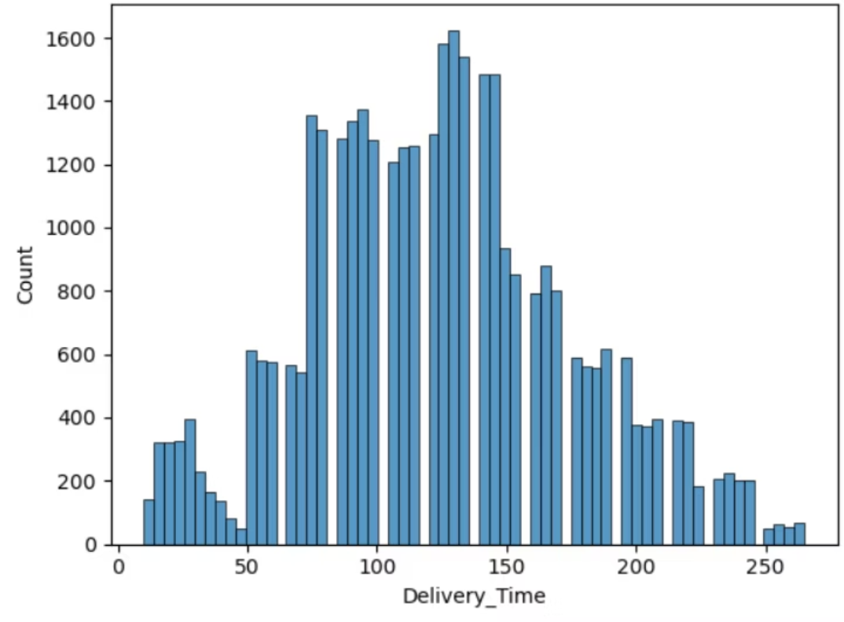
Distribution of Delivery Time (Histogram)
This graph shows how delivery time is distributed across all orders. Most deliveries fall within a normal time range, indicating consistent delivery performance. A few outliers represent delayed deliveries, which may be due to long distances, low order priority, or product-related factors. This helps understand the overall delivery behavior and identify unusual delays.

Slide 7
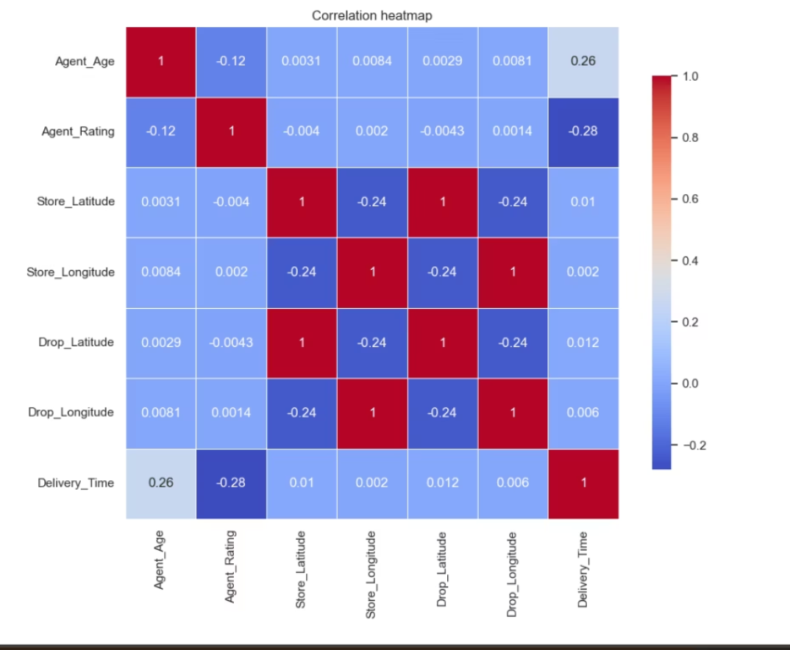
Correlation Heat Map
The heat map represents the correlation between different variables in the dataset. Darker colors indicate a stronger relationship between features. From the heat map, delivery time shows a strong positive correlation with distance, confirming that longer distances lead to increased delivery time. Other features have weaker correlations, indicating a lower impact on delivery duration compared to distance.

Slide 8




Model Performance & Results
Regression Approach
Models Evaluated
Tested multiple algorithms for optimal accuracy
Linear Regression, Decision Tree, Random Forest,
SVM
Best Performer
SVM is Selected based on comprehensive metrics
MAE
MSE
RMSE
Mean Absolute Error
Mean Squared Error
Root Mean Squared Error
Average prediction deviation
Penalizes larger errors
Standard deviation of errors
R²
R² Score
Variance explained by model

Slide 9
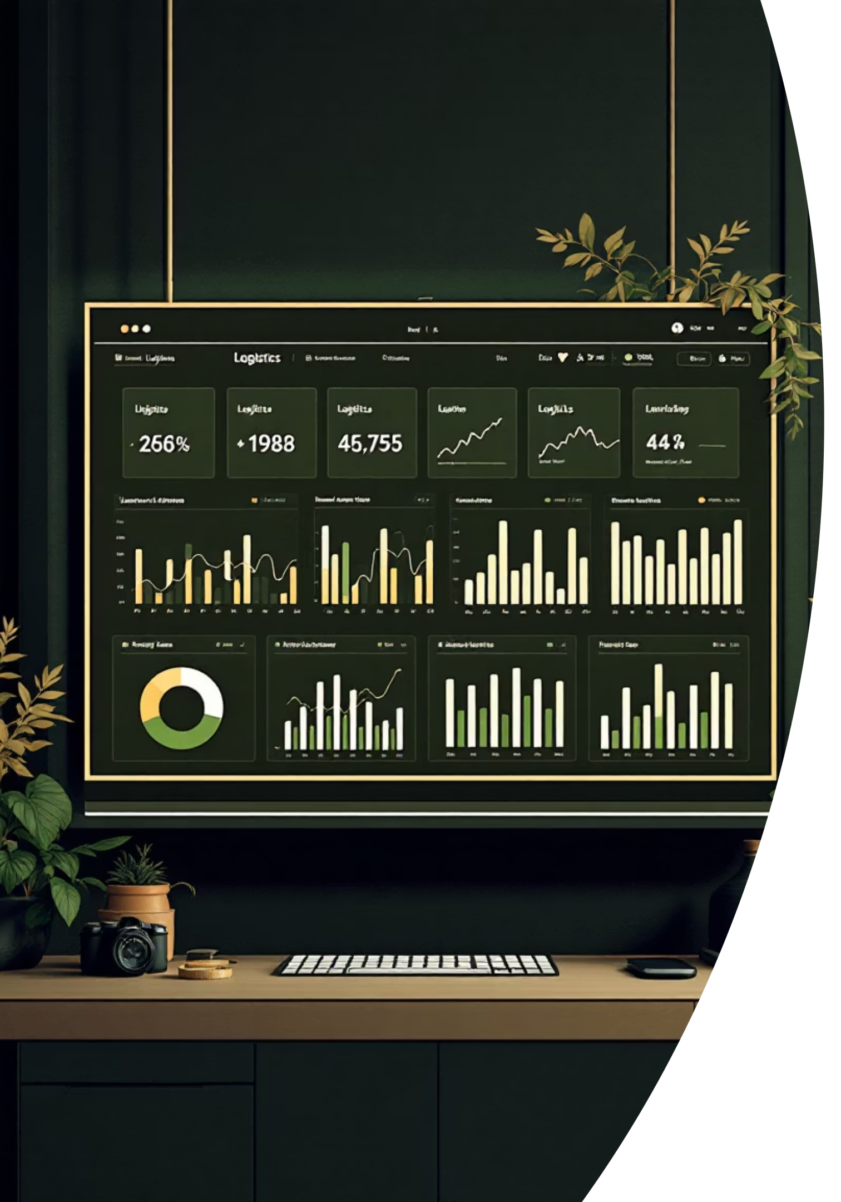



Business Intelligence Dashboard
Visual Analytics
Interactive dashboard built with Power BI for real-time insights
Delivery Trends
Tracks temporal patterns and geographic delivery performance
Decision Support
Empowers stakeholders with actionable logistics intelligence

Slide 10




Key Findings & Conclusions
Prediction Accuracy
Regression models successfully predict delivery times with high precision
Primary Driver
Distance emerged as the most influential predictor variable
Business Value
Enhanced customer satisfaction through improved logistics planning and transparency

Slide 11

Thank You !

